Slide 1
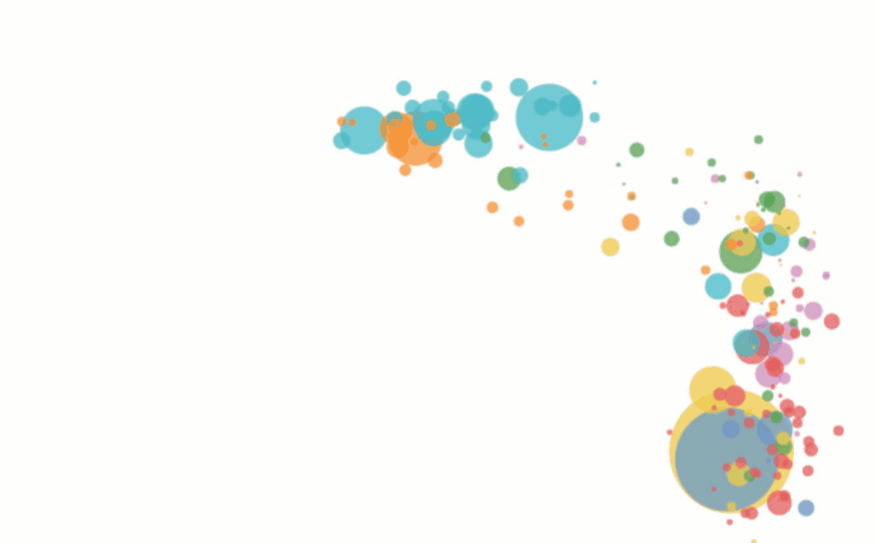
Transforming Data into Dashboards

Slide 2
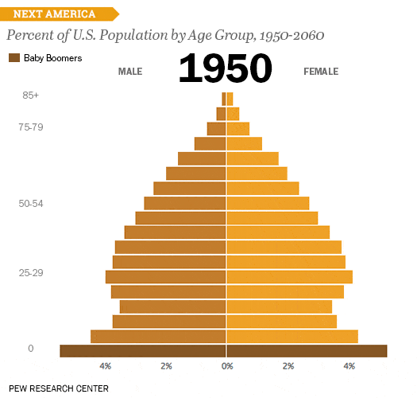

Slide 3


Slide 4
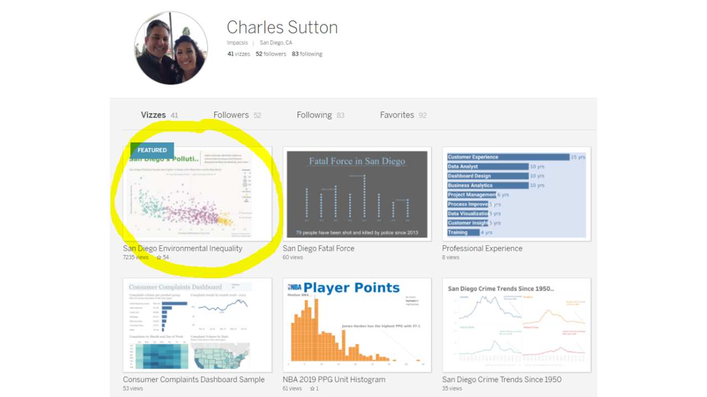

Slide 5


Slide 6
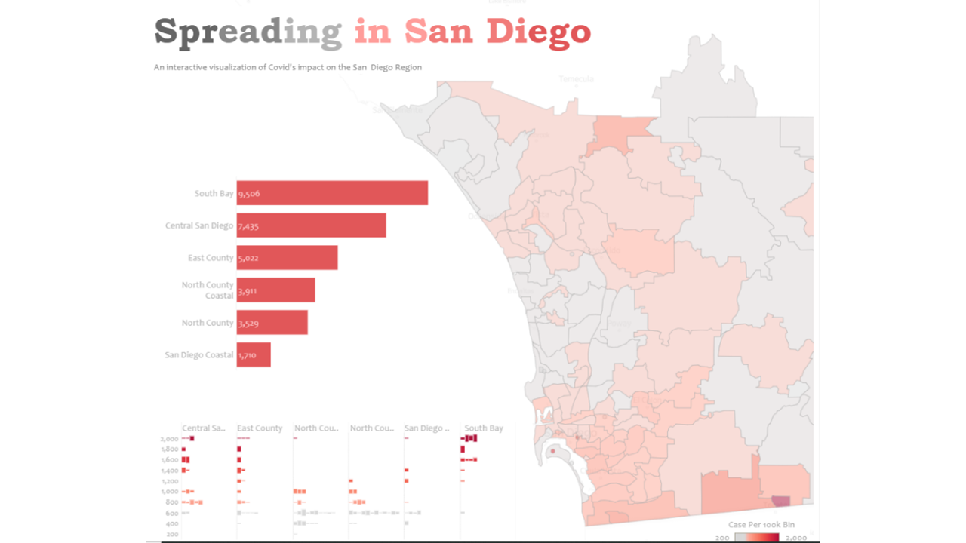

Slide 7
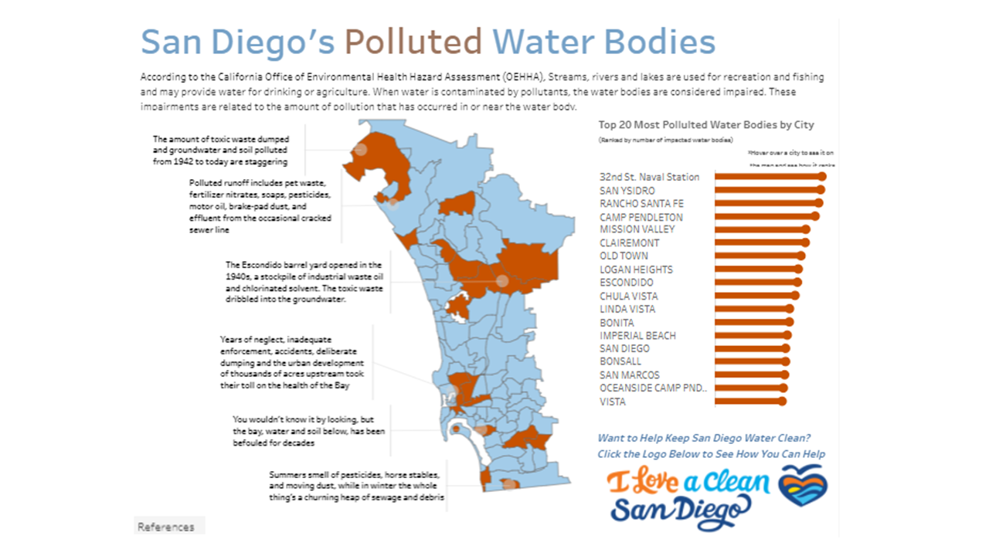

Slide 8
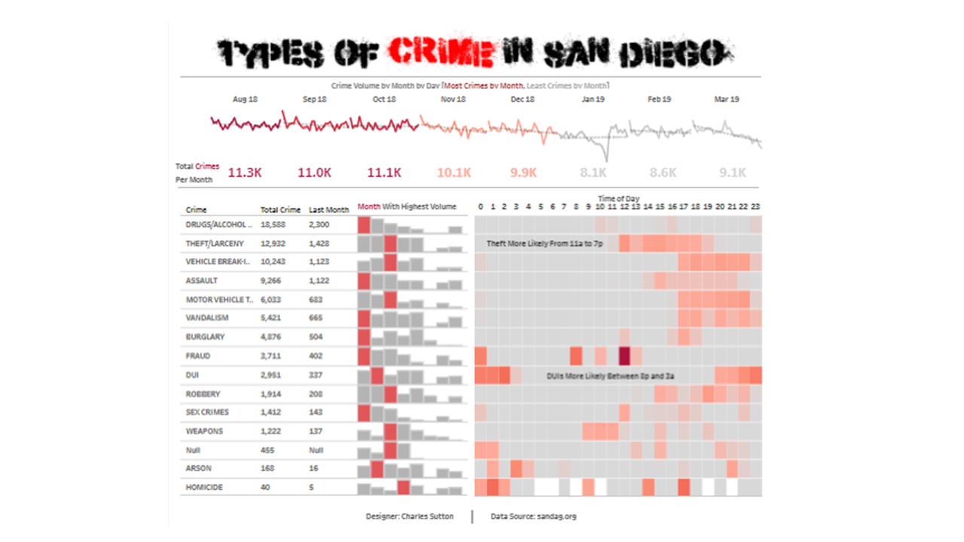

Slide 9




Slide 10
Not a Tool

Slide 11
A Community

Slide 12
Learn From Others

Slide 13
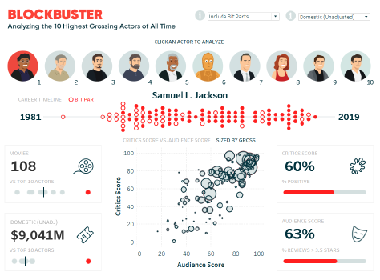
Credit: Ryan Sleeper

Slide 14
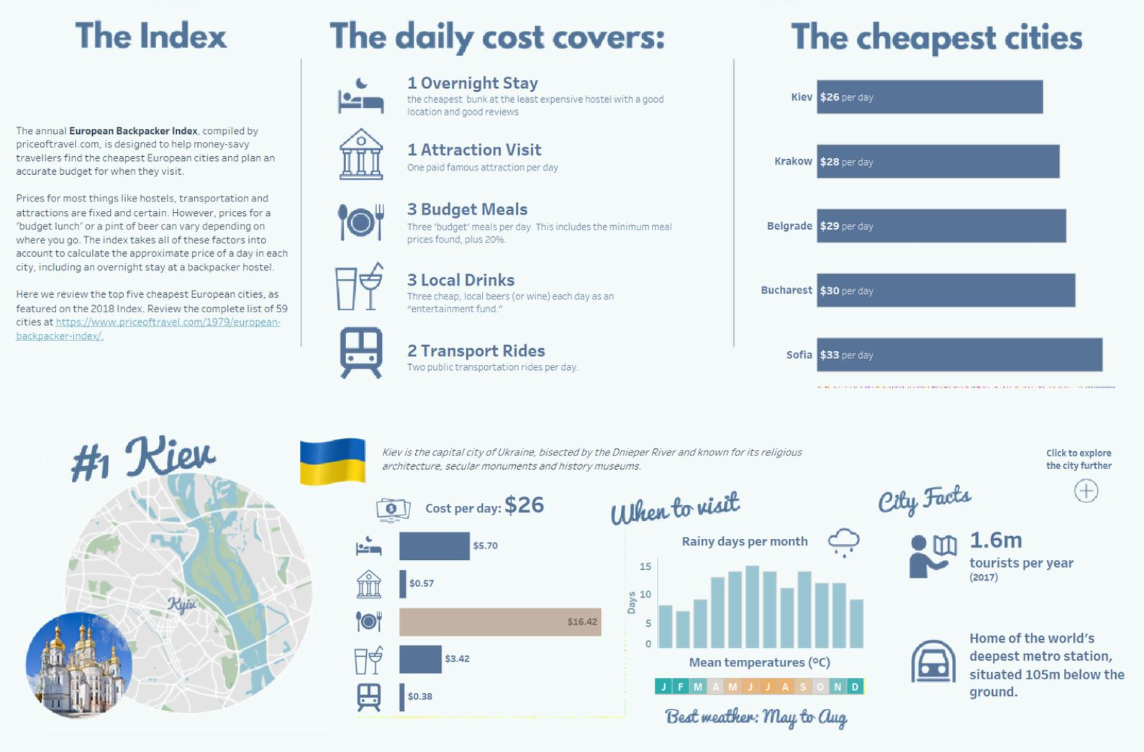
Credit: Sarah Bartlett

Slide 15
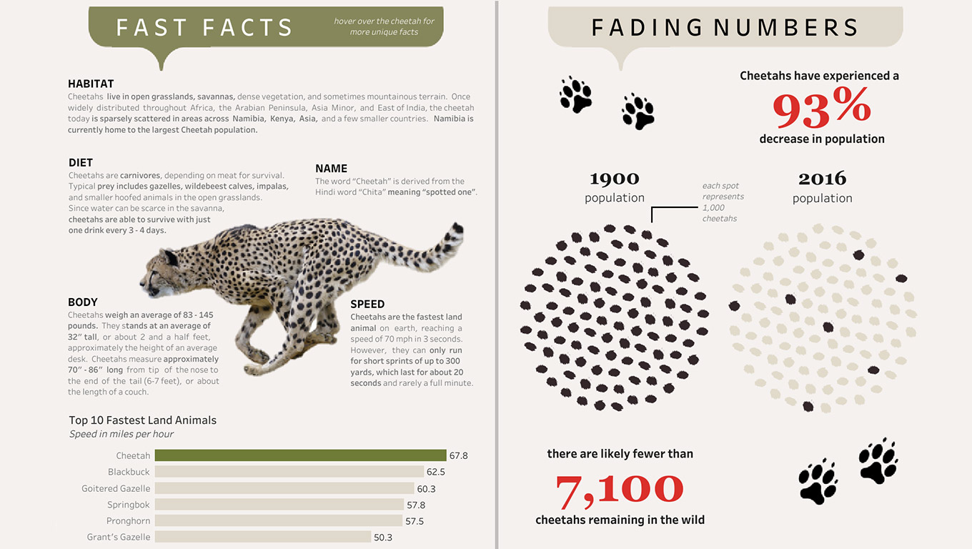
Credit: Lindsey Betzendahl

Slide 16
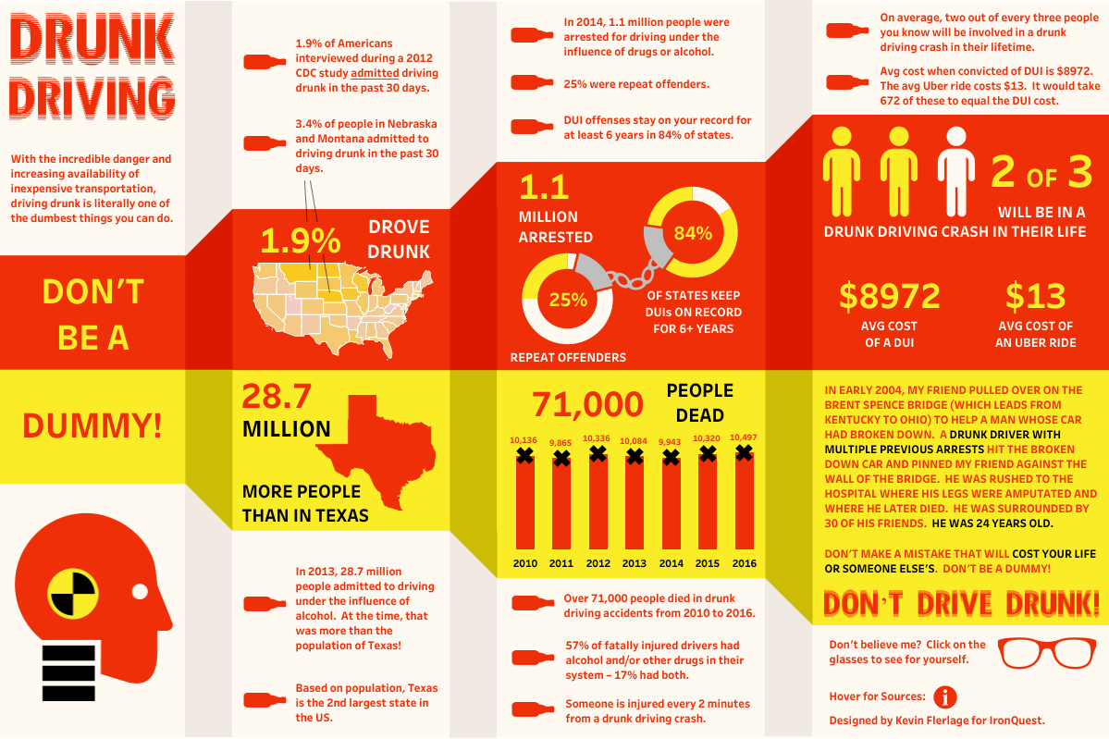
Credit: Ken Flerlage

Slide 17
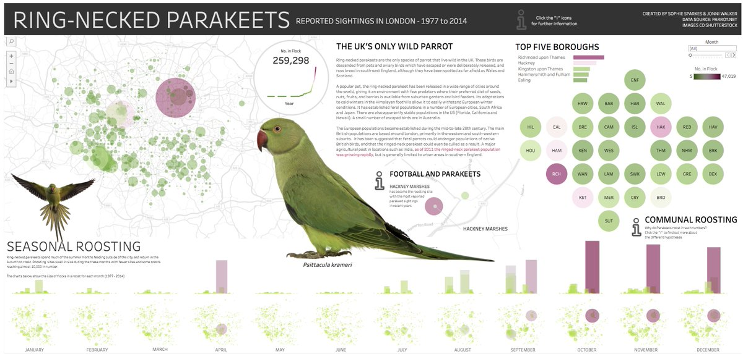
Credit: Johnni Walker

Slide 18


Slide 19


Slide 20


Slide 21


Slide 22
Tryout Tuesday

Slide 23
Simple Design

Slide 24
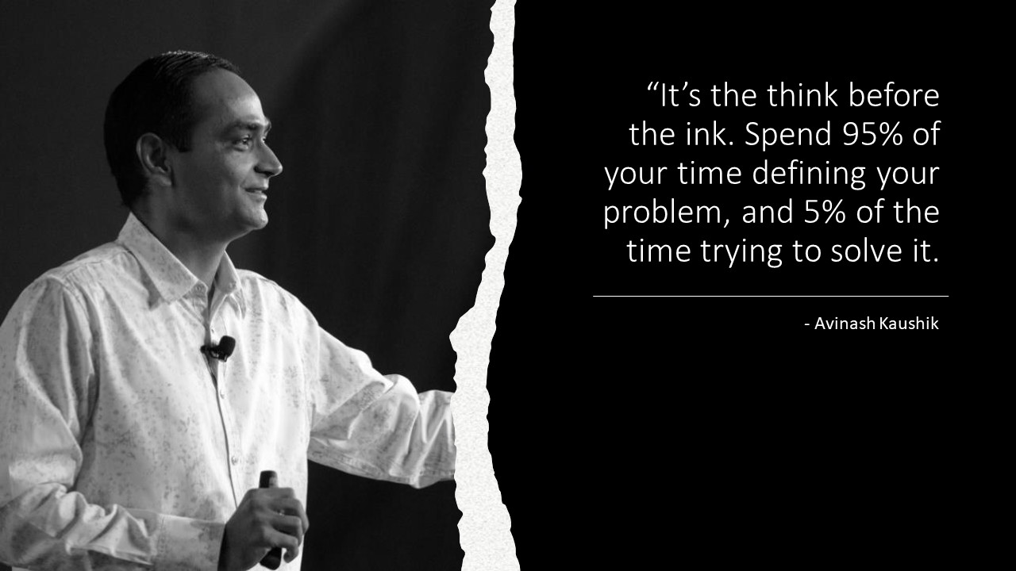

Slide 25


Slide 26
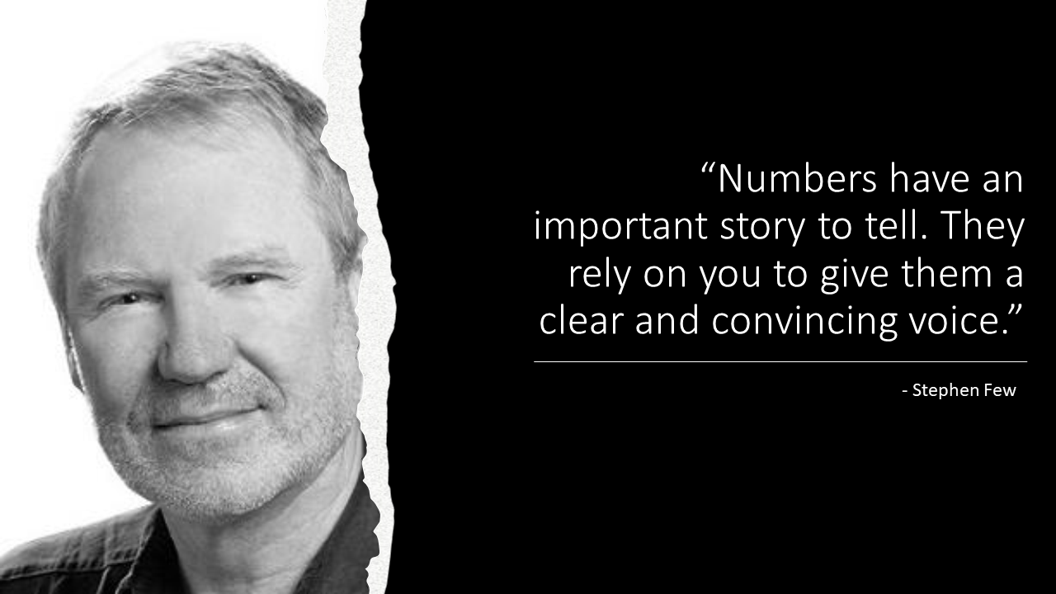

Slide 27


Slide 28
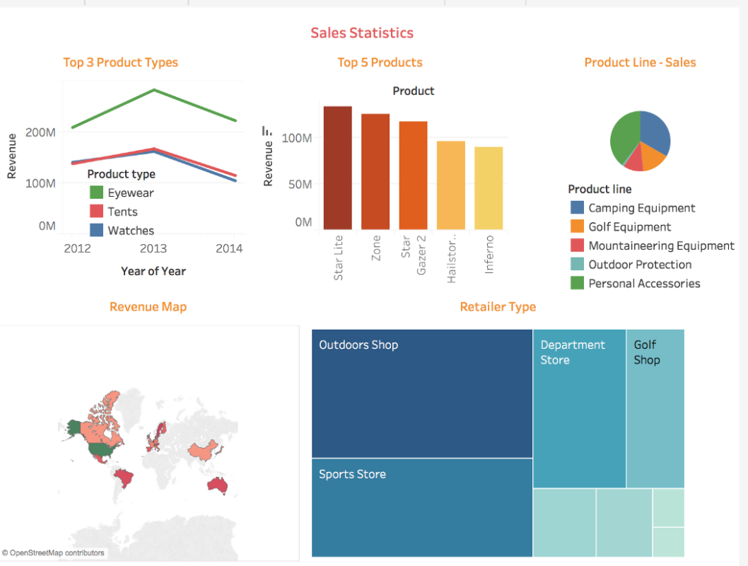
Credit: Tableau

Slide 29
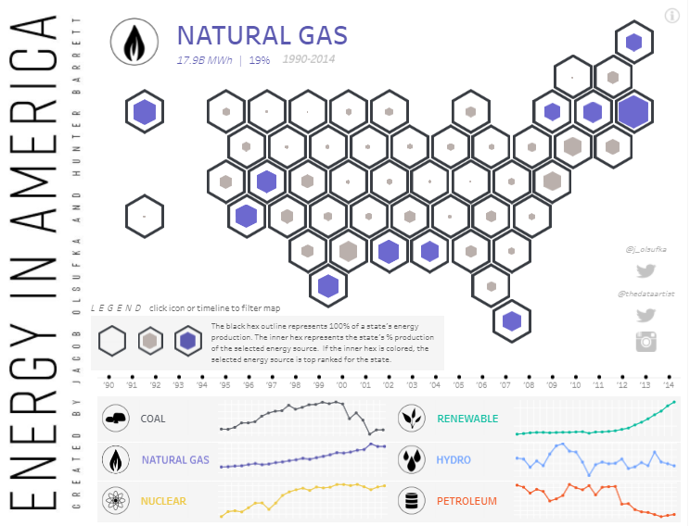
Credit: Olsufka

Slide 30
Upload Data
Create Visualizations
Create a Dashboard
Publish to Web

Slide 31
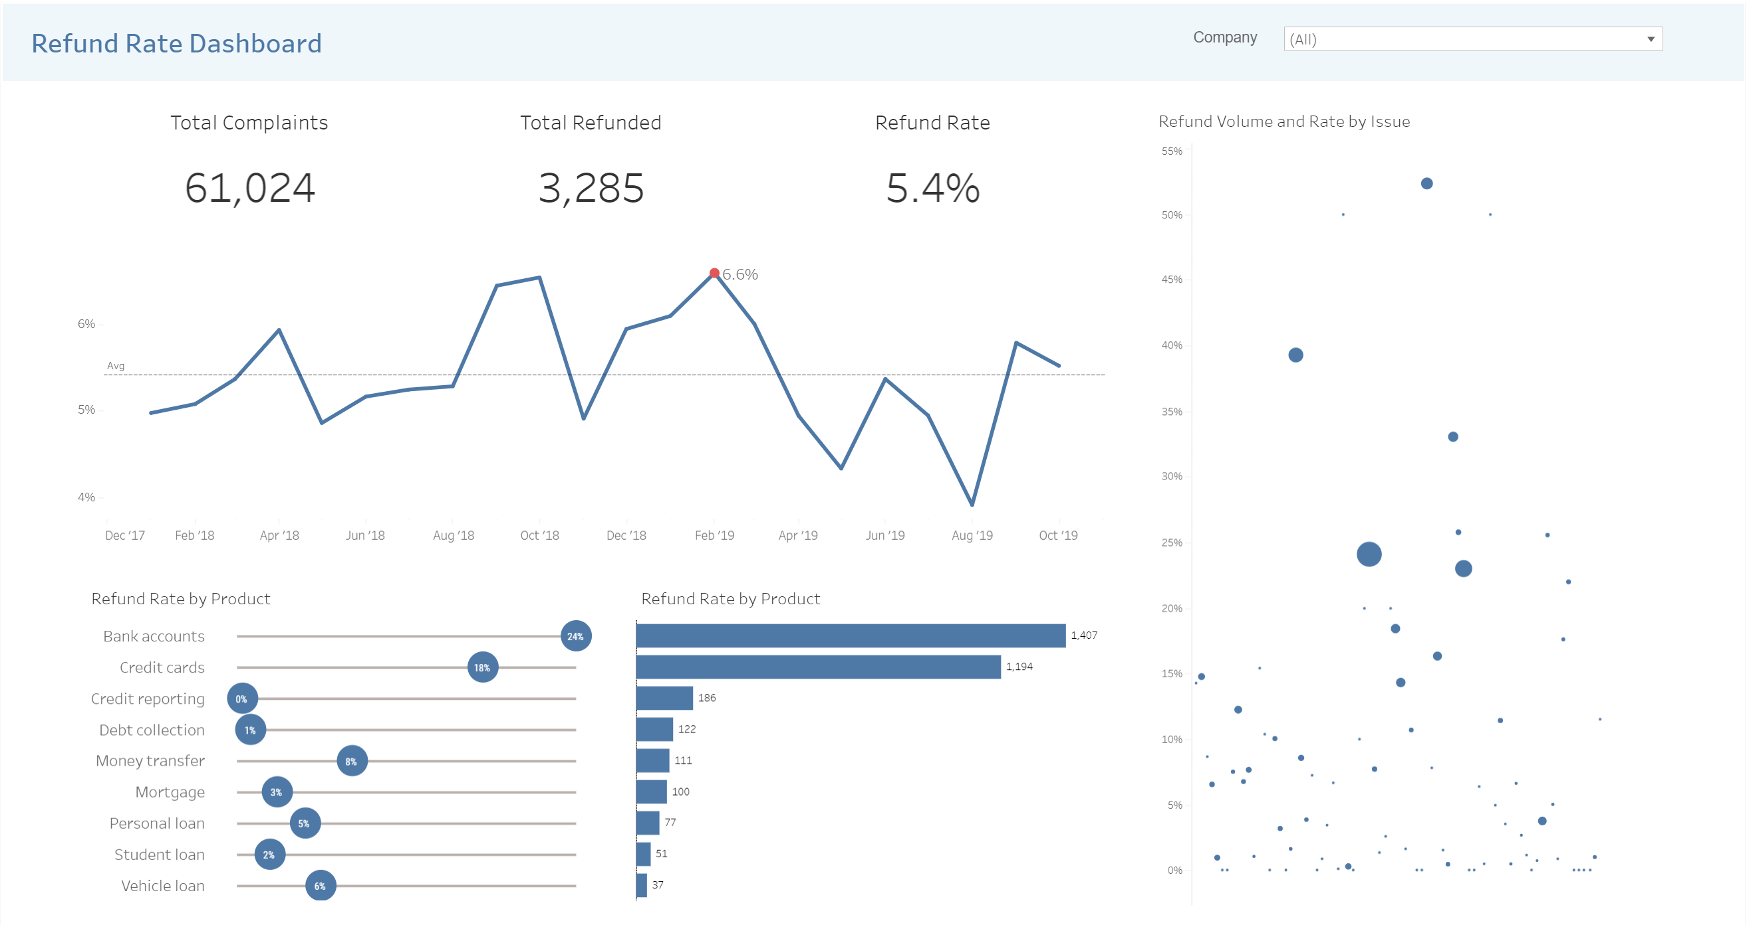

Slide 32
Get Some Data and Start Building

Slide 33
Bang Boxes

Slide 34
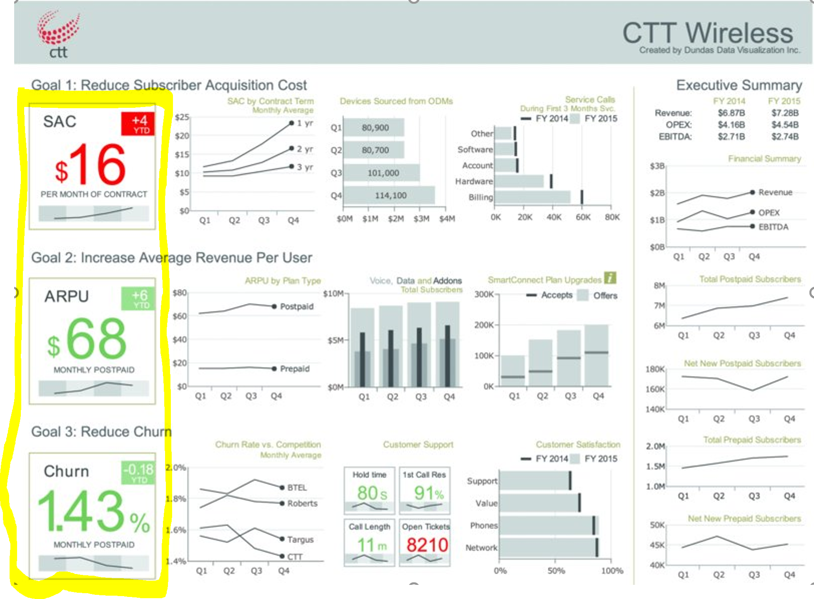
Credit: Cotgreave, Shaffer, and Wexler

Slide 35
Line Charts

Slide 36
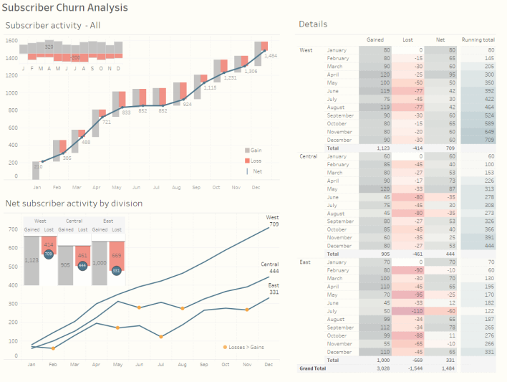
Credit: Cotgreave, Shaffer, and Wexler

Slide 37
Dot Plots

Slide 38
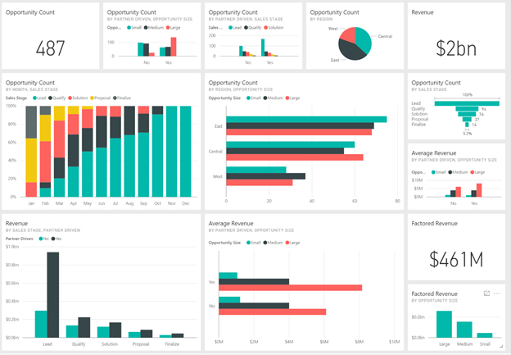
Credit: Power BI

Slide 39
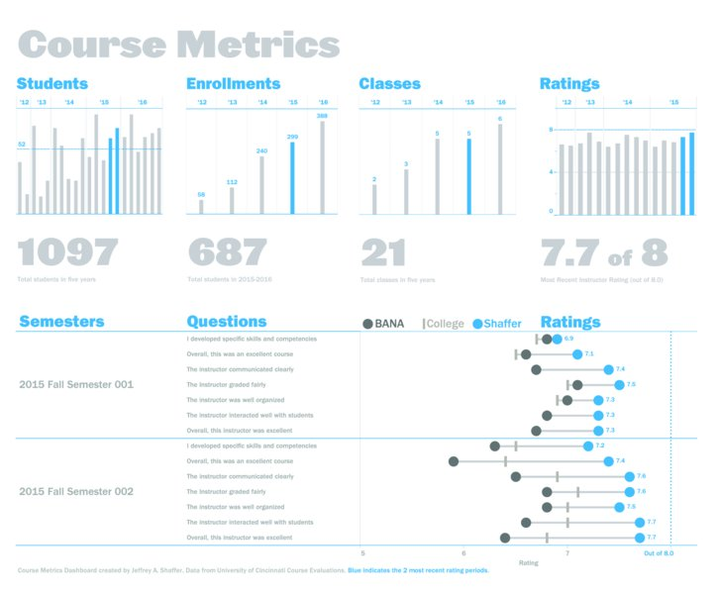
Credit: Cotgreave, Shaffer, and Wexler

Slide 40
Jitter Plot

Slide 41
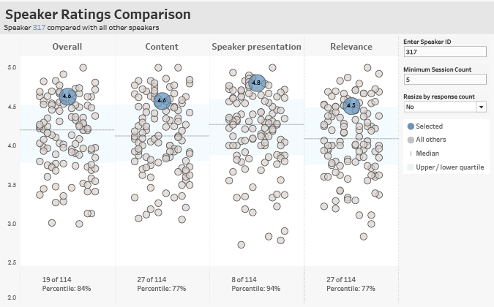
Credit: Cotgreave, Shaffer, and Wexler

